Slide 1
Healthy Belly
Mohammad Bharoocha
Josue Rodriguez
Mateo Perez
Hassan Ishmam
Priyanshi Vaishnav
Nisal Gamage

Slide 2
Problem
Malnutrition is one of the leading causes of Stillborns and Miscarriages
About 34% of Stillborns are due to bad diet (Reducing stillbirths: behavioural and nutritional interventions before and during pregnancy)
Shoppers tend to buy food without looking at Nutritional Label
Agri-Pulse Article shows 57 percent said they buy what their family likes; 49 percent said they’re satisfied with their diet or health;

Slide 3
Introducing the Healthy Belly Application
Scan and go, no need to carry a list!
How it works:
Match keywords with ingredients
Use database “Open Food Facts”
Result:
Red: Cannot eat at all
Yellow: Can eat but not too much
Green: Can eat as much as they want
Show more accurate result depending on user’s trimester
Consult doctors for verification of the unsafe items

Slide 4
Are There Other Apps That Do This?
There are apps where you can look up products and find out their contents.
Apps that do have a scanner app that show nutritional values but the user still has to figure out if the food is hazardous for them or not
Other pregnancy apps also give the user a lot of information at once causing users to feel overwhelmed
Pregnancy +: https://play.google.com/store/apps/details?id=com.hp.pregnancy.lite&hl=en_US
Pregnancy food guide! :https://apps.apple.com/us/app/pregnancy-food-guide/id1016072001
Pregnancy Food Guide: Informs the user of what is considered healthy and gives pages of background information
Our app you just scan, get fast and simple feedback and you move on
There are no other apps that does what our app does

Slide 5
Secondary Market Research
How Does Poor Diet During Pregnancy May Have Long Term Impact On Child's Health?
https://www.sciencedaily.com/releases/2008/06/080630200951.htm
Malnutrition that can cause miscarriages? (Miscarriages due to malnutrition)
https://www.ncbi.nlm.nih.gov/pmc/articles/PMC4163795/
How many people in the United States are pregnant per year?
https://www.cdc.gov/nchs/fastats/births.htm
How many people actually read the nutritional information
https://www.agri-pulse.com/articles/6952-most-people-read-nutrition-facts-label-at-least-some-of-the-time
Customer trust on information on label
https://nypost.com/2018/06/07/most-people-think-food-labels-are-misleading/
Percentile of Stillborns and miscarriages leading to miscarriages
https://www.ncbi.nlm.nih.gov/pmc/articles/PMC2679409/
What percentage of pregnant women are concerned about what they eat? To what level is that concern?
https://www.parents.com/pregnancy/my-body/nutrition/what-pregnant-women-really-eat/
And many more sources!

Slide 6
Primary Market Research
Created a set of questions for our connections in the medical field (specifically Pediatricians) to interview
Are you willing to use/test our App to see if it meets standards and if the information is accurate
How many mothers/families contact you in regards to nutrition?
What are some great sources to use to gain a better understanding of what is considered healthy, what is not considered healthy, and what is something that is considered in between?
How are malnutrition and miscarriages connected? In other words, how important is nutrition for pregnancy?
Different needs during different trimesters?
What do you think should be on the app?
What do you think would be the most important feature for this app?
Based on the information that is given do you believe that you would be okay with recommending this app to a patient.

Slide 7
Primary Market Research
Create a survey for families and friends to gauge at their shopping habits
How often do you read the ingredients or nutritional label?
How often do you google an item before buying it?
How long does it take to shop?
Would you trust an application to tell you what food is hazardous/not hazardous?
If answered no then what could we do to make you trust this app
Would you rather pay for the app or would you rather have ads
Would you rather want the app to be simple or have in depth information
Do you use any health/nutrition app

Slide 8
Sample Response
Create a survey for families and friends to gauge at their shopping habits
How often do you read the ingredients or nutritional label?
Sometimes
How often do you google an item before buying it?
Sometimes
How long does it take to shop?
1-2 Hours
Would you trust an application to tell you what food is hazardous/not hazardous?
Yes
If answered no then what could we do to make you trust this app
N/A
Would you rather pay for the app or would you rather have ads
Have ads
Would you rather want the app to be simple or have in depth information
Simple
Do you use any health/nutrition app
No

Slide 9
What Does This Tell Us?
From our results we see:
A lot of people don’t have the time or the drive to check through all the ingredients and look up if they are hazardous for them.
However there still seems to be a desire to know if something is hazardous.
Our app aims to solve these problems so we believe a market exist.

Slide 10
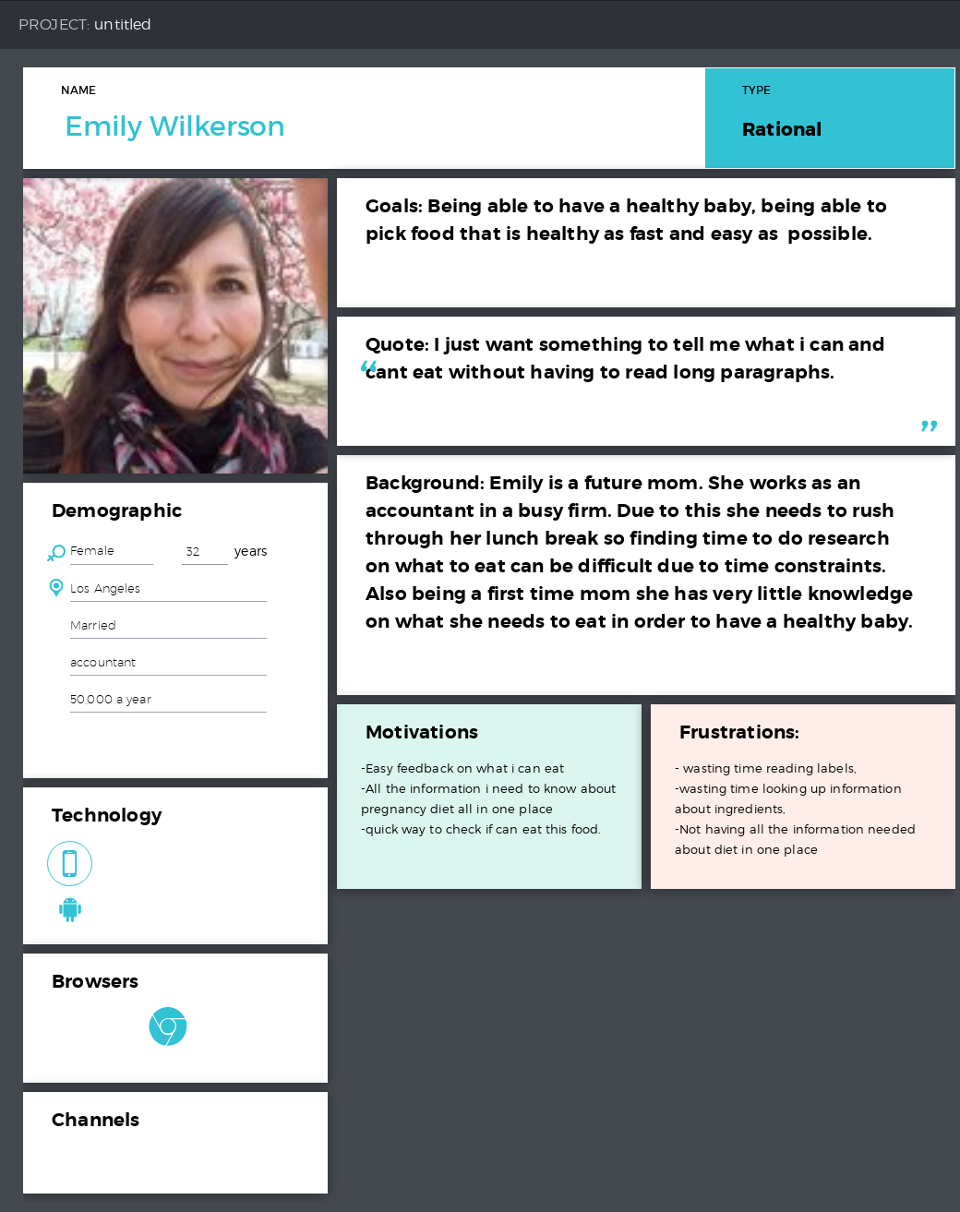
Based on Secondary Market Research
PERSONAS
Emily Wilkerson
She’s a pregnant woman, conceiving for the first time, looking for assistance with her proper dietary intake to ensure a healthy baby, but at the same time she has little to no time to read or consult with a professional every now and then.

Slide 11
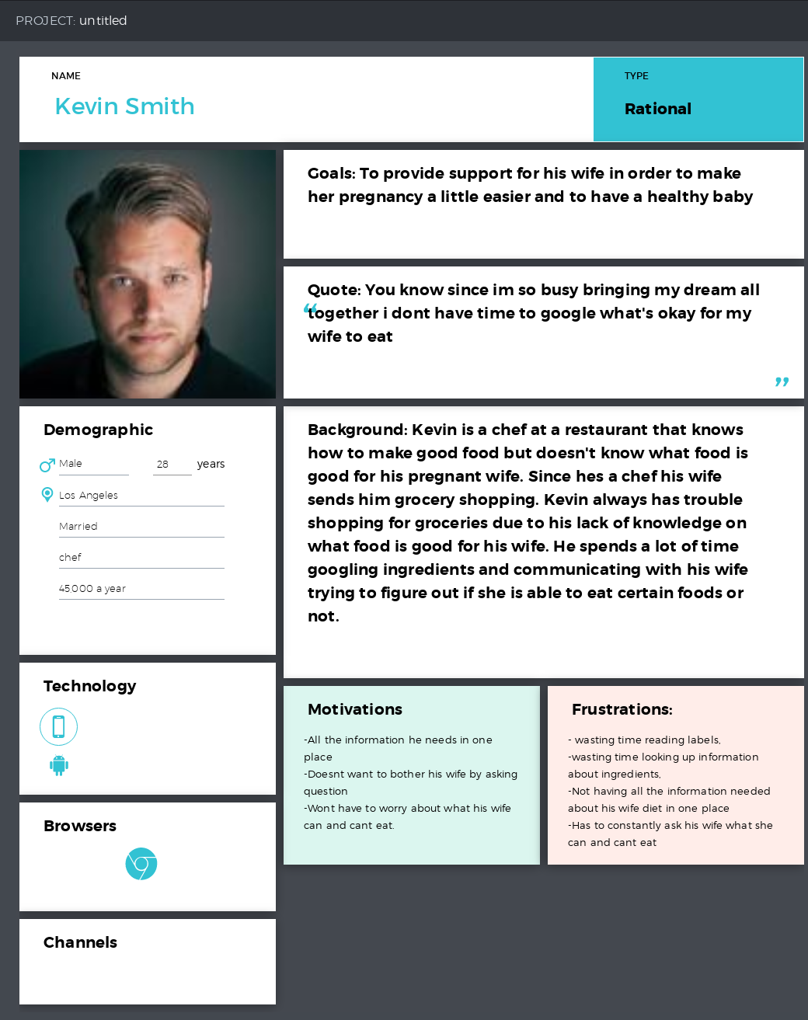
Kevin Smith
He’s the husband of a pregnant woman looking for assistance with taking care of his wife and his baby. He constantly has to ask his wife what she can and can’t eat and make sure it’s good for the baby.

Slide 12
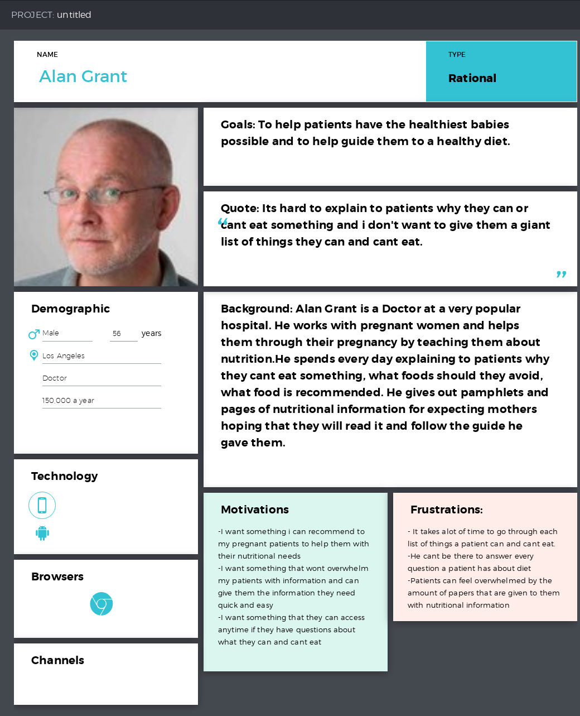
Alan Grant
He’s a doctor and his goal is to help women who are expecting soon.
He can’t be there personally to answer any ambiguity a patient might have about their diet preferences.

Slide 13
So talking about the main persona, let’s see how our app will help emily simplify her pregnancy.
Due to the simplicity of our app, emily wouldn’t need to spend time reading about everything she’s eating because of easy access that our app will grant to her about the dietary specifications.

